Slide 1
The Ups and Downs of Preposition Error Detection in ESL Writing
Joel Tetreault [Educational Testing Service]

Slide 2
What does ETS do?
Standardized Assessment
GRE
TOEFL
TOEIC
SAT
Others
Educational Tools
Criterion, Text Adaptor
Educational Policy
EVIL

Slide 3
A Brief History of ETS
1930s-1940s
1990s - 2000s
Present
1950-1980s
1930s: to get into university, one had to be wealthy or attend top prep schools
Henry Chauncey believed college admission should be based on achievement, intelligence
With other Harvard faculty, created standardized tests for military and schools
ETS created in 1947 in Princeton, NJ

Slide 4
A Brief History of ETS
1930s-1940s
1990s - 2000s
Present
1950-1980s
ETS grows into the largest assessment institution
SAT and GRE are biggest tests, with millions of students over 180 countries taking them each year
Make move from multiple choice to more natural questions (essays)

Slide 5
NLP Meets Assessment
1930s-1940s
1990s - 2000s
Present
1950-1980s
Revenue
Cost Savings for Large-Scale Assessments
Market for Practice Instruction & Assessments
Classroom Teacher Support for Writing
More practice writing possible
Individual and classroom performance assessment
Electronic writing portfolios

Slide 6
NLP Meets Assessment
1930s-1940s
1990s - 2000s
Present
1950-1980s
E-rater / CriterionSM (essay scoring)
C-rater (short answer content scoring)
Speech Rater (speech scoring)
Text Adaptor (teacher assistance tools)
Plagiarism Detection

Slide 7
E-rater
First deployed in 1999 for GMAT Writing Assessment
System Performance:
E-rater/Human agreement: 50% exact, 90% exact (+1 adjacent)
Comparable to two humans
Massive collection of 50+ weighted features organized into 5 high level features
Combined using stepwise linear regression

Slide 8
E-rater Features
Grammar
Sentence fragments, garbled words
Pronoun, possessive errors
Usage
Wrong word form, double negative
Incorrect article/preposition
Mechanics
Spelling
Punctuation
Style
Sentence length, word repetition
Passives
Organization
Discourse sequences
RST & Syntactic structures

Slide 9
Criterion
E-rater as classroom instruction/feedback tool
Used in 3200+ schools
Over 3M submissions since 2001
Over 1M student registrations
International Use:
Canada, Mexico, India, Puerto Rico, Egypt, Nepal, Taiwan, Hong Kong, Japan, Thailand, Vietnam, Brazil, UK, Greece, Turkey

Slide 10
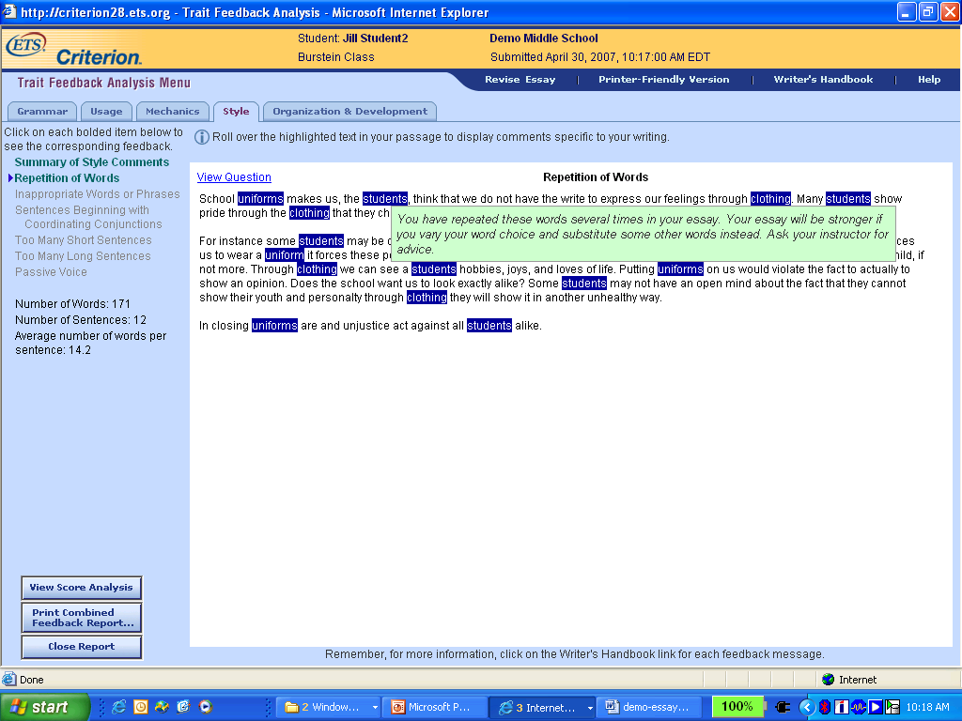

Slide 11
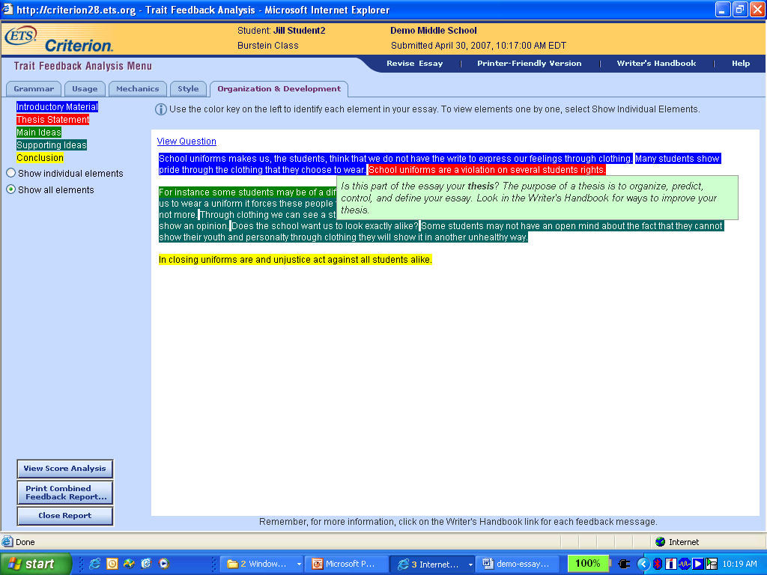

Slide 12
What’s Next for ETS?
1930s-1940s
1990s - 2000s
Present
1950-1980s
Assessment/tools for learners of English as a Second Language (ESL)
300 million ESL learners in China alone
10% of US students learn English as a second language
Teachers now burdened with teaching classes with wildly varying levels of English fluency

Slide 13
What’s Next for ETS?
1930s-1940s
1990s - 2000s
Present
1950-1980s
Increasing need for tools for instruction in English as a Second Language (ESL)
Other Interest:
Microsoft Research (ESL Assistant)
Publishing Companies (Oxford, Cambridge)
Universities
Rosetta Stone

Slide 14
Objective
Long Term Goal: develop NLP tools to automatically provide feedback to ESL learners about grammatical errors
Preposition Error Detection
Selection Error (“They arrived to the town.”)
Extraneous Use (“They came to outside.”)
Omitted (“He is fond this book.”)

Slide 15
Preposition Error Detection
Present a combined ML and rule-based approach:
State of the art performance in native & ESL texts
Similar methodology used in:
Microsoft’s ESL Assistant [Gamon et al., ’08]
[De Felice et al., ‘08]
This work is included in ETS’s CriterionSM Online Writing Service and E-Rater (GRE, TOEFL)

Slide 16
Outline
Motivation
Approach
Methodology
Feature Selection
Evaluation on Native Text (Prep. Selection)
Evaluation on ESL Text
Future Directions

Slide 17
Motivation
Preposition usage is one of the most difficult aspects of English for non-native speakers
[Dalgish ’85] – 18% of sentences from ESL essays contain a preposition error
Our data: 8-10% of all prepositions in TOEFL essays are used incorrectly

Slide 18
Why are prepositions hard to master?
Prepositions are problematic because they can perform so many complex roles
Preposition choice in an adjunct is constrained by its object (“on Friday”, “at noon”)
Prepositions are used to mark the arguments of a predicate (“fond of beer.”)
Phrasal Verbs (“give in to their demands.”)
“give in” ⬄ “acquiesce, surrender”

Slide 19
Why are prepositions hard to master?
Multiple prepositions can appear in the same context:
“When the plant is horizontal, the force of the gravity causes the sap to move __ the underside of the stem.”
Choices
to
onto
on
toward
Source
Writer
Rater 2
Rater 1
System

Slide 20
NLP & Preposition Error Detection
Methodology for Preposition Error Detection
[Tetreault & Chodorow, COLING ’08]
[Chodorow, Tetreault & Han, SIGSEM-PREP ‘07]
[Tetreault & Chodorow, WAC ’09]
Experiments in Human Annotation
Implications for system evaluation
[Tetreault & Chodorow, HJCL ‘08]

Slide 21
System Flow
Essays
Pre-Processing
Tokenized, POS, Chunk
Feature Extraction
Preposition Features
Classifier / Post-Processing
Errors Flagged
Intermediate
Outputs
NLP Modules

Slide 22
Methodology
Cast error detection task as a classification problem
Given a model classifier and a context:
System outputs a probability distribution over 34 most frequent prepositions
Compare weight of system’s top preposition with writer’s preposition
Error occurs when:
Writer’s preposition ≠ classifier’s prediction
And the difference in probabilities exceeds a threshold

Slide 23
Methodology
Develop a training set of error-annotated ESL essays (millions of examples?):
Too labor intensive to be practical
Alternative:
Train on millions of examples of proper usage
Determining how “close to correct” writer’s preposition is

Slide 24
Feature Selection
Prepositions are influenced by:
Words in the local context, and how they interact with each other (lexical)
Syntactic structure of context
Semantic interpretation

Slide 25
Feature Extraction
Corpus Processing:
POS tagged (Maxent tagger [Ratnaparkhi ’98])
Heuristic Chunker
Parse Trees?
“In consion, for some reasons, museums, particuraly known travel place, get on many people.”
Feature Extraction
Context consists of:
+/- two word window
Heads of the following NP and preceding VP and NP
25 features consisting of sequences of lemma forms and POS tags

Slide 26
Features
Feature | No. of Values | Description
PV | 16,060 | Prior verb
PN | 23,307 | Prior noun
FH | 29,815 | Headword of the following phrase
FP | 57,680 | Following phrase
TGLR | 69,833 | Middle trigram (pos + words)
TGL | 83,658 | Left trigram
TGR | 77,460 | Right trigram
BGL | 30,103 | Left bigram
He will take our place in the line

Slide 27
Features
Feature | No. of Values | Description
PV | 16,060 | Prior verb
PN | 23,307 | Prior noun
FH | 29,815 | Headword of the following phrase
FP | 57,680 | Following phrase
TGLR | 69,833 | Middle trigram (pos + words)
TGL | 83,658 | Left trigram
TGR | 77,460 | Right trigram
BGL | 30,103 | Left bigram
He will take our place in the line
PV
PN
FH

Slide 28
Features
Feature | No. of Values | Description
PV | 16,060 | Prior verb
PN | 23,307 | Prior noun
FH | 29,815 | Headword of the following phrase
FP | 57,680 | Following phrase
TGLR | 69,833 | Middle trigram (pos + words)
TGL | 83,658 | Left trigram
TGR | 77,460 | Right trigram
BGL | 30,103 | Left bigram
He will take our place in the line.
TGLR

Slide 29
Combination Features
MaxEnt does not model the interactions between features
Build “combination” features of the head nouns and commanding verbs
PV, PN, FH
3 types: word, tag, word+tag
Each type has four possible combinations
Maximum of 12 features

Slide 30
Combination Features
Class | Components | +Combo:word
p-N | FH | line
N-p-N | PN-FH | place-line
V-p-N | PV-PN | take-line
V-N-p-N | PV-PN-FH | take-place-line
“He will take our place in the line.”

Slide 31
Preposition Selection Evaluation
Test models on well-formed native text
Metric: accuracy
Compare system’s output to writer’s
Has the potential to underestimate performance by as much as 7% [HJCL ’08]
Two Evaluation Corpora:
WSJ
test=106k events
train=4.4M NANTC events
Encarta-Reuters
test=1.4M events
train=3.2M events
Used in [Gamon+ ’08]

Slide 32
Preposition Selection Evaluation
Model | WSJ | Enc-Reu*
Baseline (of)* | 26.7% | 27.2%
Lexical | 70.8% | 76.5%
+Combo | 71.8% | 77.4%
+Google | 71.6% | 76.9%
+Both | 72.4% | 77.7%
+Combo +Extra Data | 74.1% | 79.0%
* [Gamon et al., ’08] perform at 64% accuracy on 12 prep’s

Slide 33
Evaluation on Non-Native Texts
Error Annotation
Most previous work used only one rater
Is one rater reliable? [HJCL ’08]
Sampling Approach for efficient annotation
Performance Thresholding
How to balance precision and recall?
May not want to optimize a system using F-score
ESL Corpora
Factors such as L1 and grade level greatly influence performance
Makes cross-system evaluation difficult

Slide 34
Training Corpus for ESL Texts
Well-formed text → training only on positive examples
6.8 million training contexts total
3.7 million sentences
Two training sub-corpora:
MetaMetrics Lexile
11th and 12th grade texts
1.9M sentences
San Jose Mercury News
Newspaper Text
1.8M sentences

Slide 35
ESL Testing Corpus
Collection of randomly selected TOEFL essays by native speakers of Chinese, Japanese and Russian
8192 prepositions total (5585 sentences)
Error annotation reliability between two human raters:
Agreement = 0.926
Kappa = 0.599

Slide 36
Expanded Classifier
Pre
Filter
Maxent
Post
Filter
Extran.
Use
Data
Output
Model
Pre-Processing Filter
Maxent Classifier (uses model from training)
Post-Processing Filter
Extraneous Use Classifier (PC)

Slide 37
Pre-Processing Filter
Pre
Filter
Maxent
Post
Filter
Extran.
Use
Data
Output
Model
Spelling Errors
Blocked classifier from considering preposition contexts with spelling errors in them
Punctuation Errors
TOEFL essays have many omitted punctuation marks, which affects feature extraction
Tradeoff recall for precision

Slide 38
Post-Processing Filter
Pre
Filter
Maxent
Post
Filter
Extran.
Use
Data
Output
Model
Antonyms
Classifier confused prepositions with opposite meanings (with/without, from/to)
Resolution dependent on intention of writer
Benefactives
Adjunct vs. argument confusion
Use WordNet to block classifier from marking benefactives as errors

Slide 39
Prohibited Context Filter
Pre
Filter
Maxent
Post
Filter
Extran.
Use
Data
Output
Model
Account for 142 of 600 errors in test set
Two filters:
Plural Quantifier Constructions (“some of people”)
Repeated Prep’s (“can find friends with with”)
Filters cover 25% of 142 errors

Slide 40
Thresholding Classifier’s Output
Thresholds allow the system to skip cases where the top-ranked preposition and what the student wrote differ by less than a pre-specified amount

Slide 41
Thresholds
FLAG AS ERROR
“He is fond with beer”

Slide 42
Thresholds
FLAG AS OK
“My sister usually gets home by 3:00”

Slide 43
Results
Model | Precision | Recall
Lexical | 80% | 12%
+Combo:tag | 82% | 14%
+Combo:tag +Extraneous | 84% | 19%

Slide 44
Typical System Errors
Noisy context
Other errors in vicinity
Sparse training data
Not enough examples of certain constructions
Biased training data

Slide 45
Related Work
 | Method | Performance
[Eeg-Olofsson et al. ’03] | Handcrafted rules for Swedish learners | 11/40 prepositions correct
[Izumi et al. ’03, ’04] | ME model to classify 13 error types | 25% precision 7% recall
[Lee & Seneff ‘06] | Stochastic model on restricted domain | 80% precision 77% recall
[De Felice & Pullman ’08] | ME model (9 prepositions) | ~57% precision ~11% recall
[Gamon et al. ’08] | LM + decision trees (12 prepositions) | 80% precision

Slide 46
Future Directions
Noisy Channel Model (MT techniques)
Find specific errors or do sentence rewriting
[Brockett et al., ‘06; Hermet et al., ‘09]
Artificial Error Corpora
Insert errors into native text to create negative examples
[Foster et al., ‘09]
Test long-range impact of error modules on student writing

Slide 47
Future Directions [WAC ’09]
Current method of training on well-formed text is not error-sensitive:
Some errors are more probable than others
e.g. “married to” vs. “married with”
Different L1’s make different types of errors
German: “at Monday”; Spanish: “in Monday”
These observations are commonly held in the ESL teaching/research communities, but are not captured by current NLP implementations

Slide 48
“Region Web Counts” Approach
In the absence of a large error-annotated ESL corpus, how does one find common errors?
ex: *“married with John” vs. “married to John”
Novel approach: use region-specific searches to gather data on how different L1’s use certain English constructions
Region (or nation) searches = “advanced search”
Previous work has shown usefulness of web-counts for certain NLP tasks
[Lapata & Keller, ’03; Kilgarriff, ‘07]

Slide 49
Web-Counts Example
Region | “depends on” | “depends of” | Ratio
US | 92,000,000 | 267,000 | 345:1
France | 1,500,000 | 22,700 | 66:1
* Counts using Google on March 6, 2009
“depends of” is over 5 times more likely to appear in France than in the US
France’s small ratio may signal a potential error

Slide 50
Summary
Proof of Concept results appear promising:
Showed metric can detect known errors
Biasing training data could have a big impact
Long Range Goal: Automatically determine common errors
Run methodology on thousands of constructions
Preliminary results on 8500 bigrams appear favorable
Add more training data for flagged constructions; determine performance improvement from new model

Slide 51
Conclusions
Presented a state-of-the-art preposition error detection methodology
State-of-the-art preposition selection performance: 79%
Accurately detects preposition errors in ESL essays with P=0.84, R=0.19
This work is included in ETS’s CriterionSM Online Writing Service and E-Rater
ESL error detection is a growing subfield with a more quickly growing demand
Great area for dissertation or project ideas!

Slide 52
Acknowledgments
Researchers
Martin Chodorow [Hunter College of CUNY]
Na-Rae Han [University of Pittsburgh]
Annotators
Sarah Ohls [ETS]
Waverly Vanwinkle [ETS]
Other
Jill Burstein [ETS]
Michael Gamon [Microsoft Research]
Claudia Leacock [Butler Hill]

Slide 53
Some More Plugs
NLP in ETS
Postdocs
Summer Interns
4th Workshop on Innovative Use of NLP for Educational Applications (NAACL-09)
http://www.cs.rochester.edu/u/tetreaul/naacl-bea4.html
NLP/CL Conference Calendar
Google “NLP Conferences”
http://www.cs.rochester.edu/u/tetreaul/conferences.html

