Slide 1
Lipstick on a Pig: Debiasing Methods Cover up Systematic Gender Biases in Word Embeddings But do not Remove Them
Ke Lyu
03.12.2019

Slide 2
Overview
Introduction
Gender Bias in Word Embeddings
Experimental Setup
Experiments and Results
Discussion and Conclusion

Slide 3
Introduction
Gender bias
Consistent and pervasive
Reduce the gender bias in word embeddings
Hide the bias rather than remove it

Slide 4
Gender Bias in Word Embeddings
Existing Debiasing Methods
post-processing dibiasing method
Train debiased word embeddings from scratch
Remaining bias after using debiasing methods
Methods and results rely on the specific bias definition

Slide 5
Experimental Setup
Refer to the word embeddings of the previous works
HARD-DEBIASED
GN-GLOVE
Word Embedding Association Test (WEAT)

Slide 6
Experiments and Results

Slide 7
Male- and female-biased words cluster together
(a) Clustering for HARD-DEBIASED embedding, before (left hand-side) and after (right hand-side) debiasing.
(b) Clustering for GN-GLOVE embedding, before (left handside) and after (right hand-side) debiasing.
Figure 1: Clustering the 1,000 most biased words, before and after debiasing, for both models.

Slide 8
Bias-by-projection correlates to bias-byneighbours
The percentage of male/female socially-biased words among the k nearest neighbors of the target word
Measure the correlation of this new bias measure with the original bias measure

Slide 9
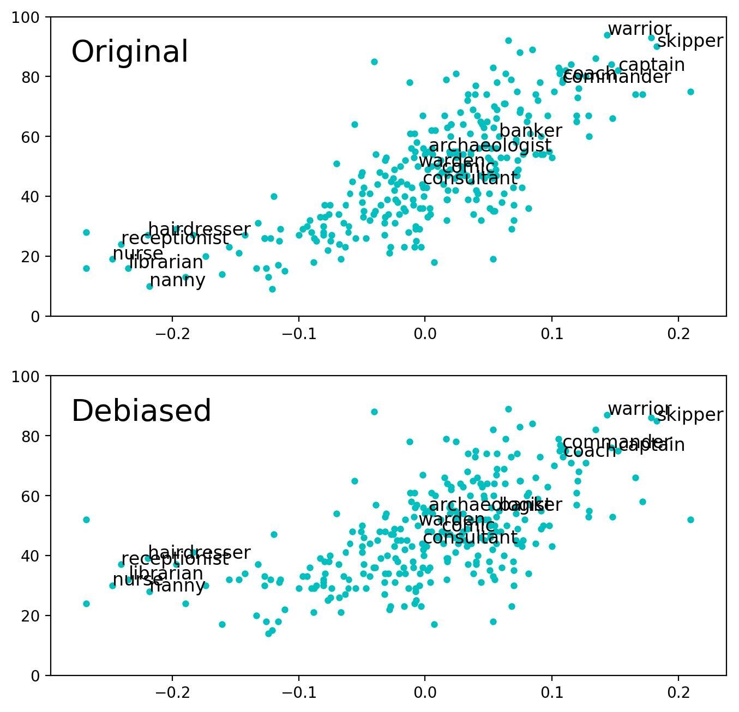
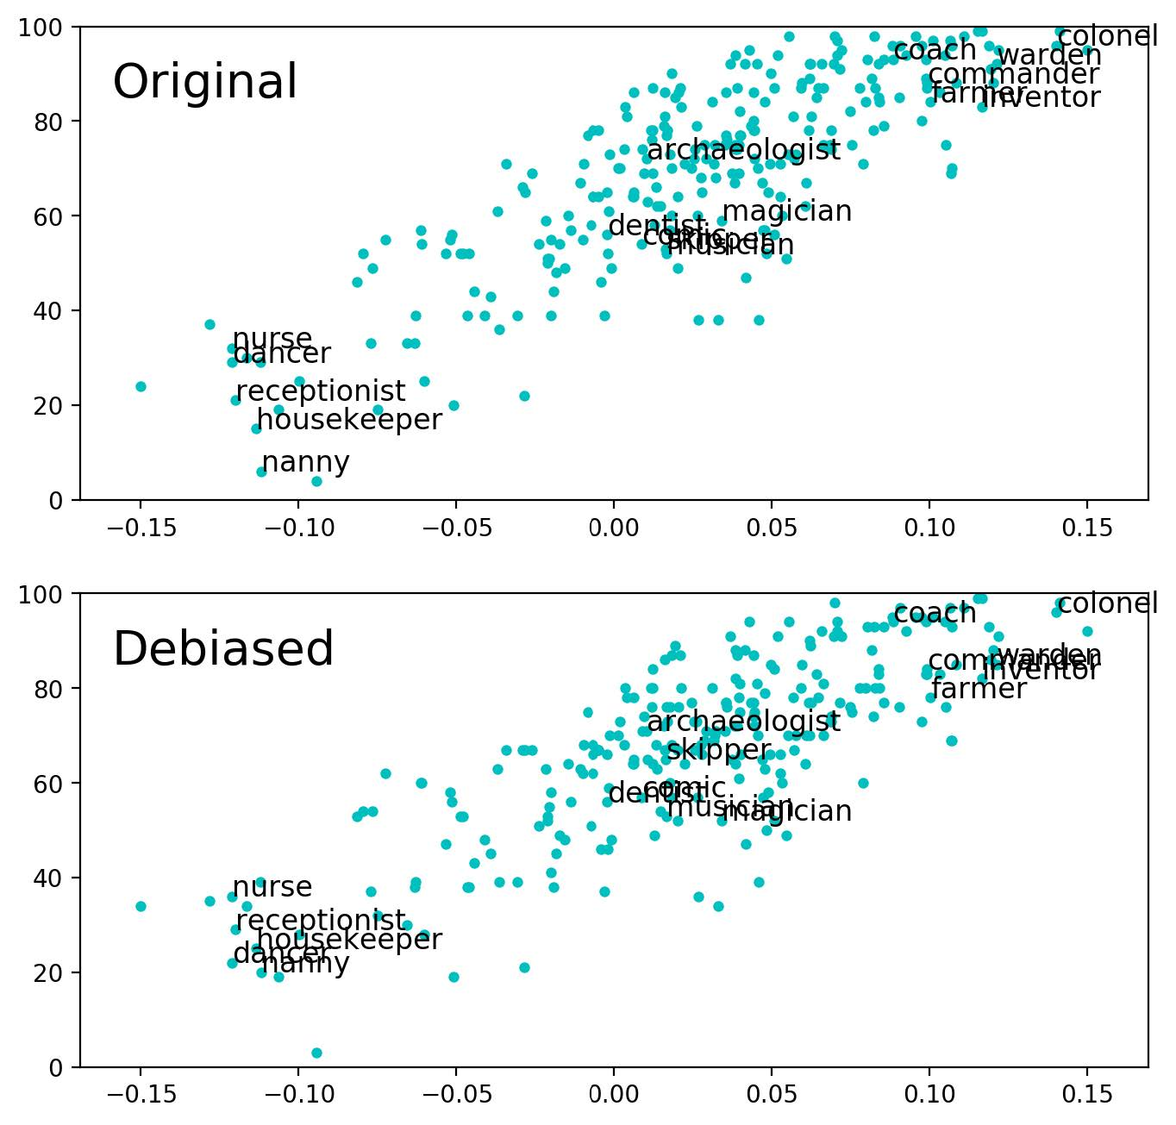
Professions
(a) The plots for HARD-DEBIASED embedding, before (top) and after (bottom) debiasing.
(b) The plots for GN-GLOVE embedding, before (top) and after (bottom) debiasing.
Figure 2: The number of male neighbors for each profession as a function of its original bias, before and after
debiasing. We show only a limited number of professions on the plot to make it readable.

Slide 10
Association between female/male and female/male-stereotyped words
female/male names and family and career words
female/male concepts and arts and mathematics words
female/male concepts and arts and science words

Slide 11
Classifying previously female- and male-biased words
consider the 5,000 most biased words according to the original bias
The HARD-DEBIASED embedding
The GN-GLOVE embedding

Slide 12
Discussion and Conclusion
Words with strong previous gender bias
Words that receive implicit gender from social stereotypes
The implicit gender of words with prevalent previous bias

Slide 13
It’s All in the Name: Mitigating Gender Bias with Name-Based Counterfactual Data Substitution
Ke Lyu
03.12.2019

Slide 14
Overview
Introduction
Improvements to CDA
Experimental Setup
Results
Conclusion

Slide 15
Introduction
Direct bias & Indirect bias
Two proposals
Counterfactual Data Substitution (CDS)
The Names Intervention

Slide 16
Counterfactual Data Substitution (CDS)
Apply substitutions probabilistically (0.5)
Substitutions are performed on a per-document basis

Slide 17
The Names Intervention
Provide a method for better counterfactual augmentation
An explicit treatment of first names

Slide 18
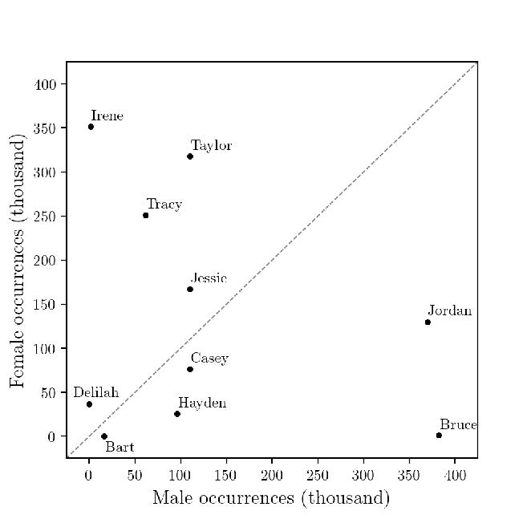
The Names Intervention
Figure 2: Frequency and gender-specificity of names in the SSA dataset

Slide 19
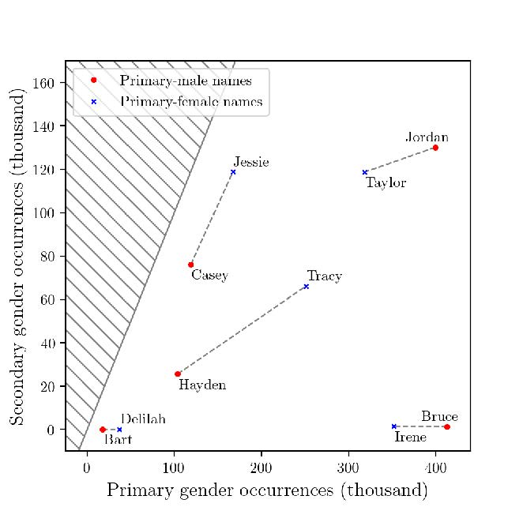
Improvements to CDA
Figure 3: Bipartite matching of names by frequency and gender-specificity

Slide 20
Experimental Setup
Compare eight variations
CDA , gCDA, nCDA, Gcds, nCDS
WED40, WED70, nWED70
none

Slide 21
Experimental Setup
Perform an comparison on two corpora
Gigaword
Wikipedia
Our evaluation matrix and methodology is expanded below.

Slide 22
Direct bias
Compute Cohen’s d and a one-sided p-value
Three tests which measure the strength of various gender stereotypes
art–maths
arts–sciences
careers–family

Slide 23
Indirect Bias
whether the most-biased words remain clustered
whether a classifier can be trained to reclassify the gender of debiased words.

Slide 24
Word similarity
The quality of a space
Similarity scores

Slide 25
Sentiment classification
Quantify downstream performance
The classification is performed by an SVM classifier

Slide 26
Non-biased gender analogies
506 analogies in the family analogy subset
proportional pair-based analogy test

Slide 27
Results

Slide 28
Direct bias
Table 1: Direct bias results

Slide 29
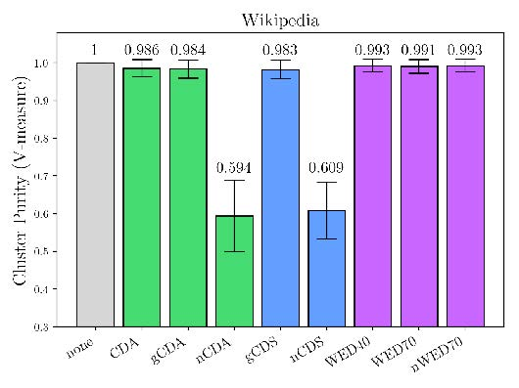
Indirect bias
Figure 5: Most biased cluster purity results

Slide 30
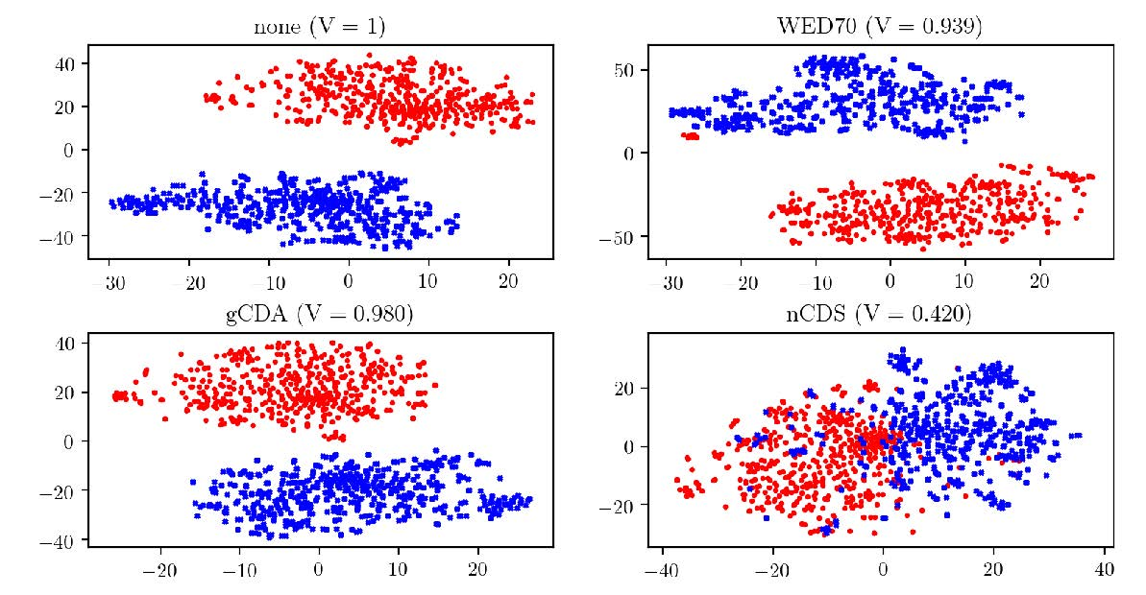
Indirect bias
Figure 6: Clustering of biased words (Gigaword)

Slide 31
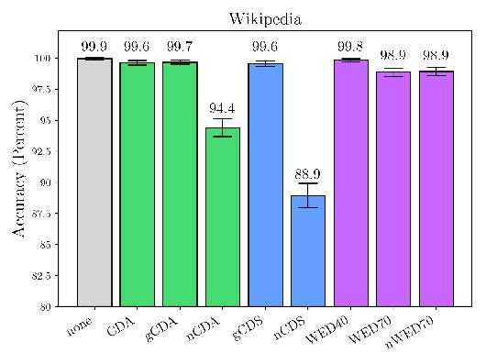
Indirect bias
Figure 7: Reclassification of most biased words results

Slide 32
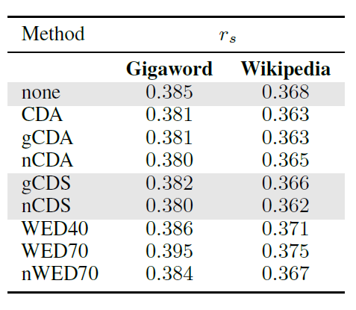
Word similarity
Table 2: Word similarity Results

Slide 33
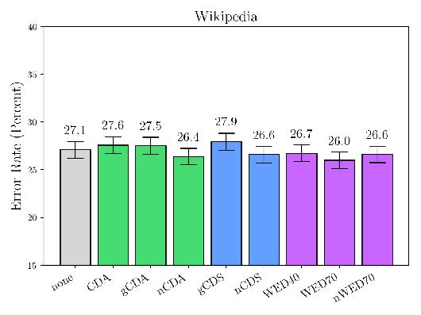
Sentiment classification
Figure 8: Sentiment classification results

Slide 34
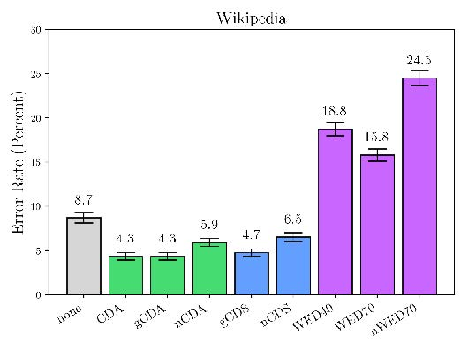
Non-biased gender analogies
Figure 9: Non-biased gender analogy results

Slide 35
Conclusion

Slide 36
Conclusion
WED and CDA, on Wikipedia and the English Gigaword
A fundamental limitation
Extend the Names Intervention

Slide 37
Thanks for your listening!

