Slide 1
MWE Discovery based on semantic analyse
He Mingyang
Institut für Computerlinguistik
Ruprecht-Karls-Universität Heidelberg
19.11.2019

Slide 2
Paper
Zhai (1997):Exploiting Context to Identify Lexical Atoms-- A Statistical View of Linguistic Context
Salehi et al. (2015): A Word Embedding Approach to Predicting the Compositionality of Multiword Expressions

Slide 3
Chengxiang Zhai
Computational Linguistics M.S. 1995
Carnegie Mellon Univ., Pittsburgh, PA Language and Info. Technologies Ph.D. 2002
Professor of Computer Science at the University of Illinois in Urbana-Champaign.
Research Interests: Information Retrieval, Text Mining, Natural Language Processing, Machine Learning and Bioinformatics

Slide 4
Salehi
Data Scientist
PhD Student The University of Melbourne, Australia
MSc (Artificial Intelligence), Shiraz University, Iran 2011
BSc (Computer Science), Shiraz University, Iran 2008

Slide 5
Exploiting Context to Identify Lexical Atoms-- A Statistical View of Linguistic Context

Slide 6
Lexical atom
Lexical atom is multiple word phrase that have no compositional meaning
Example : “ Hot dog” , “TV-Dinner”
Counterexample: “ Stock market”
Need to be decided by the context: “ white house”

Slide 7
Motivation
Lexicographists: Want to identify lexical atoms and list them as independent lexicon entries.
Information retrieval: It is desirable to recognize and use lexical atoms for indexing.
Machine translation : A lexical atom needs to be translated as a single unit, rather than word by word.

Slide 8
Two major approaches of studying lexical semantics
Generative apporch:
The intensional and extensional content of the lexical item is described;
Exploits online dictionaries and extracts lexical information from the entry definition;
Inherently hard to identify lexical atoms using the generative approach. (because of non compositionality)
Contextual approach: Exploits the online text or large corpora to extract lexical collocations.

Slide 9
Linguistic Context
Desirable to exploit as much contextual information as possible
But: extremely hard to obtain a deep and detailed representation of context in unrestricted domains
Simplified Context: we restrict the linguistic context of a word/phrase to the surrounding words of the word/phrase within a certain boundary (e.g., a 50-word, or 10-sentence text window).

Slide 10
Three statistical heuristics to measure the compositionality
Formal definition of Lexical Atom: A two word noun phrase [X Y] is a lexical atom, if and only if the meaning of [X Y] is not a direct composition of the regular literal meanings of X and Y.
Phrase-Word Cooccurrence (PWC) measure
Word Association (WA) measure
Context Similarity (CS) measure

Slide 11
Phrase-Word Cooccurrence (PWC) measure
Based on the observation that if the meaning of [X Y] is radically different from X
(or Y), X (or Y) will be unlikely to occur in the context of [X Y].

Slide 12
Word Association (WA) measure
Based on the observation that if [X Y] is non-compositional, then, it is unlikely that the association [X Y] comes from the general semantic association between X and Y. Thus, if we take the association [X Y] away from the text, we will not expect X and Y to have strong association.

Slide 13
Context Similarity (CS) measure
The weight of a context word can be determined simply by counting the occurrences of the word in all the N-word contexts of w
Or also considering the global frequency of the context word.
idf-tf scoring from Information: retrieval techniques
FQ(c:w)/log(FQ(c)+1)
Given a word w, collect all the context words
Each context word is given a weight that measures its association with w,
The weights of all the context words of w form a vector that quantitatively characterizes the context of w.

Slide 14
Experiments
Corpus: Initial 20-megabyte chunk from the Associate Press Newswire 89 corpus
Tagged with a lexicon
All functional words were dropped
400 most frequent noun-noun pairs were generated as the candidate set of lexical atoms.
Compositionality value:
PWC measure: the product of the two PWC values with respect to each word
CS measure: Sum of two individual CS values
Context: 80 Words
Mutual Information method

Slide 15
The top 10 word pairs for four different measures

Slide 16
The bottom 5 word pairs for four different measures

Slide 17
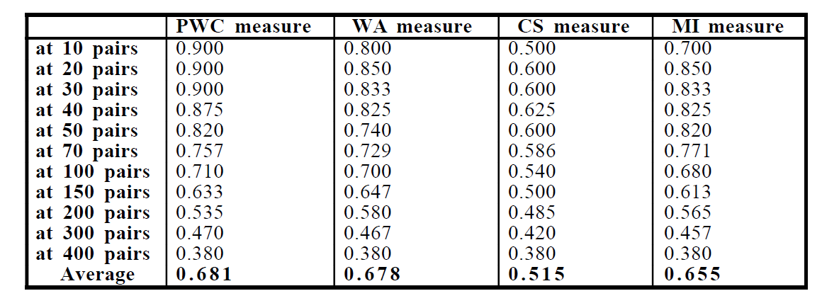
Precisions for four different measures

Slide 18
Figure 1. Precision curves for four different measures

Slide 19
Precision of merged results from PWC and MI measures

Slide 20
Reflection
Advantage of the PWC and CS measures: Provide an individual compositionality value->explain why it is a lexical atom
“heart” and “attack” are 1.016 and 0.056
“red cross” are 0.023 and 0.015 respectively, which means neither “red” nor “cross” carries its regular meaning in “red cross”
Computational complexity, the PWC, MI, and WA measures are significantly better than the CS measure.
Context:
A lot of useful information such as the syntactic/semantic relations has been ignored.
Relative position of the words within a context has not considered.
However, even such a simplified notion of context can be very useful.

Slide 21
A Word Embedding Approach to Predicting the Compositionality of Multiword Expressions

Slide 22
Multiword expressions
Word combinations that display idiomaticity.
The semantics of the MWE (e.g. ivory tower) cannot be predicted from the semantics of the component words
Recent NLP work： “Compositionality prediction”
Identifying various morphosyntactic and semantic relations (Mikolov et al., 2013a),
Dependency parsing (Bansal et al., 2014),
Sentiment analysis (Socher et al., 2013),
Named-entity recognition (Collobert andWeston, 2008; Passos et al., 2014)
Machine translation (Zou et al., 2013; Devlin et al., 2014).
This Paper: First attempt to use Word Embedding to predict MWE

Slide 23
Methodology
Different vector-space models:
(1) Simple count-based model of distributional similarity;
(2) Word embeddings based on WORD2VEC;
(3) Multi-sense skip-gram model
Pre-tokenise the corpus to represent each MWE as a single token
Cannot perform any form of lemmatization: For Language Independency

Slide 24
Count-Based Distributional Similarity
Top 50 most-frequent words are considered to be stopwords
Words with frequency rank 51–1051 are considered to be the content-bearing words

Slide 25
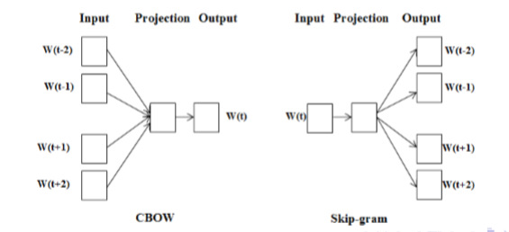
WORD2VEC
Based on the recurrent neural network language model (RNNLM)
Iterate over all words in the corpus and either
Use context words to predict current word (CBOW)
Use current word to predict context words (Skipgram)

Slide 26
Multi-Sense Skip-gram Model
Multi-Sense Skip-gram:
Let each sense of word have its own embedding
Induce the senses by clustering the embeddings of the context words around each token.
Vector representation of the context is the average of its context words’ vectors
For every word type, we maintain clusters of its contexts and the sense of a word token is predicted as the cluster that is closest to its context representation

Slide 27
Compositionality of the MWE

Slide 28
Dataset
(1) English noun compounds (“ENCs”, e.g. spelling bee and swimming pool);
(2) English verb particle constructions (“EVPCs”, e.g. stand up and give away);
(3) German noun compounds (“GNCs”, e.g. ahornblatt “maple leaf” and eidechse “lizard”).

Slide 29
English noun compounds “ENCs“
1. Consists of 90 binary English noun compounds
2. Annotated on a continuous [0, 5] scale for both overall compositionality and
the component-wise compositionality of each of the modifier and head noun
3.State of art method: supervised support vector regression(Count Based)

Slide 30
The EVPC dataset
Consists of 160 English verb particle constructions
Manually annotated for compositionality on a binary scale for each of the head verb and particle
State-of-the-art method:
(1) The distributional method
(2) The same method applied to 10 target languages (under word and MWE translation, selecting the languages using supervised learning)
(3) The string similarity method

Slide 31
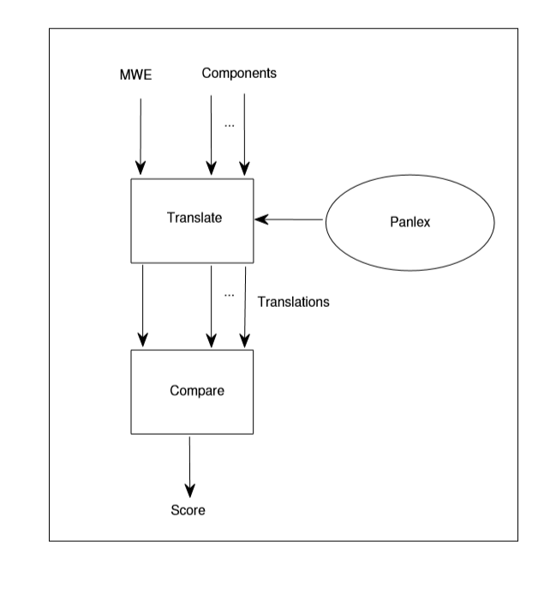
String Similarity Method

Slide 32
The GNC dataset
Consists of 246 German noun Compounds
Annotated on a continuous [1, 7] scale
State-of-the-art method: Distributional similarity method applied to part-of-speech tagged and lemmatized data (the context word is restricted to some type of part-of-speech, for example adjective or noun)

Slide 33
Experiment
Train models over raw text Wikipedia corpora for either English or German, depending on the language of the dataset.
Using the WP2TXT toolbox4 to eliminate XML and HTML tags and hyperlinks, and punctuation
was removed
For the small numbers of MWEs : Assign a default value
Baseline: Translation string similarity approach
Comp1 is set to 1.0 for EVPC, and 0.7 for both ENC and GNC

Slide 34
RQ1: Are word embeddings superior to conventional count-based models of distributional similarity?
RQ2: How sensitive to parameter optimisation are different word embedding approaches?
RQ3: Are multi-prototype word embeddings empirically superior to single-prototype word embeddings?

Slide 35
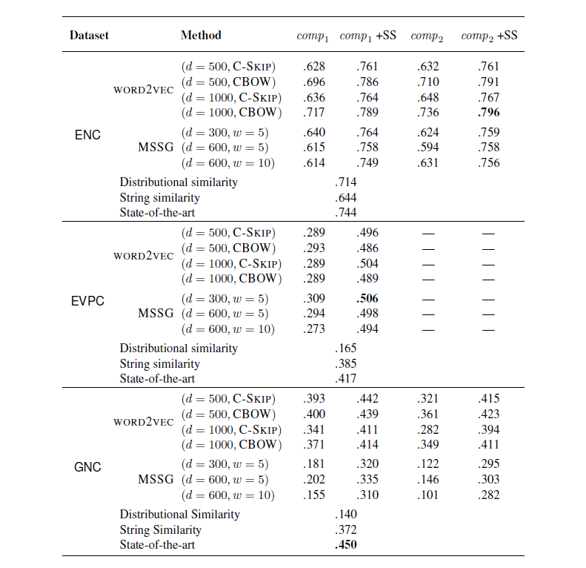

Slide 36
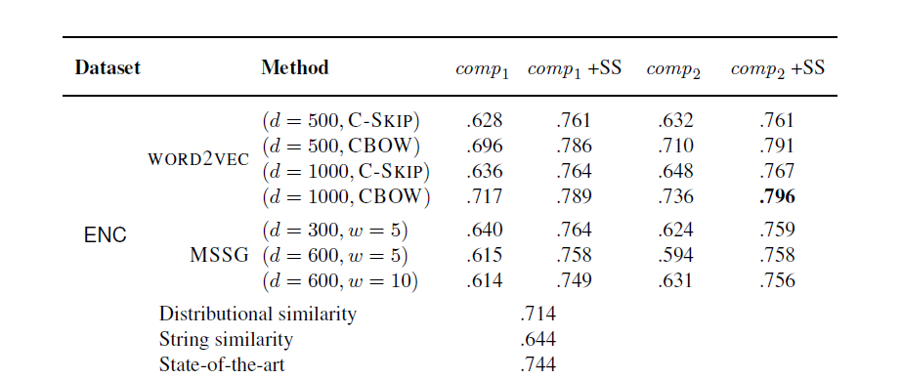

Slide 37
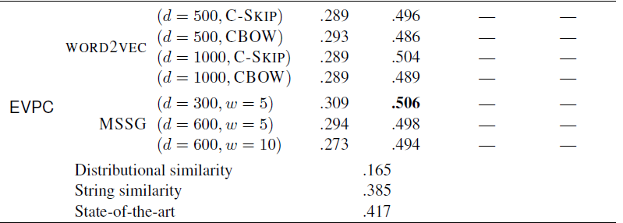

Slide 38
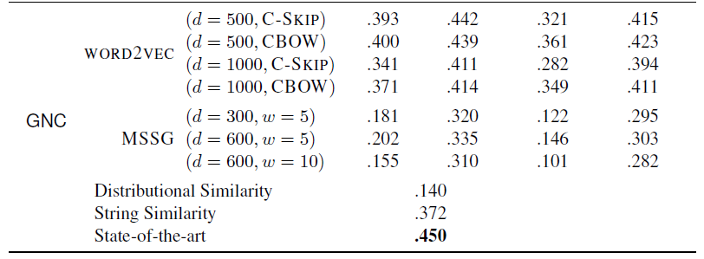

Slide 39
The effect of the number of prototypes on the results with MSSG
Default: 2 Prototype
Retrained MSSG over the range [1, 6]
Reran our experiments for each set of embeddings over the three datasets (without string similarity)
ENC EVPC: Best at 5
GNC: Best at 1

Slide 40
Vielen dank für eure Aufmerksamkeit！

